Slide 1
Euchre Player AI
Team 8 – Andrew Klenotic & Dylan Stavarz

Slide 2
The Situation:
Euchre is a card game played by four individuals in 2 teams of 2.
Coordinating schedules to allow four people to play at the same time can be difficult.
Last minute conflicts can cause one or more players to be unable to participate on short notice.
In these cases having a remedy to replace one or more players by a computer AI would be useful.
The computer AI would be designed to replace the human player at a real table in order to preserve the feel and enjoyment of actual tabletop play and social interaction absent in a fully computerized game.

Slide 3

The Parameters: (For Common Rules)
Uses the cards 9 through Ace of each of the four suits, for 24 cards.
Each player is dealt 5 cards.
Partners generally can not actively communicate with each other.
The options at any point in the game are finite and can be enumerated.
The winning conditions (or goal state) can be defined.

Slide 4
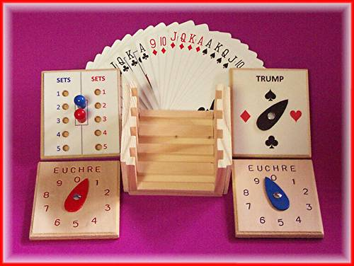
The Requirements:
Computer AI must be able to make decisions in the Calling Round regarding the selection of the suit for Trump.
On the computer’s turn, the AI must be able to analyze the cards played and make an optimal play based on the cards in the AI’s “hand”.
The AI will know when it is it’s turn to play and will indicate to the human players which card will be played.

Slide 5

The Potential Obstacles:
The AI will need to have an input method to read both cards dealt to it and cards in hand without the human players knowing.
Separate AI routines will be necessary for the Calling Round and the general game.
The AI will have to indicate the card to be played or discarded without the human players knowing it’s hand.

Slide 6

The Stretch Goals (Optional):
Creating a method to allow the computer to actually take the role as dealer (physically dealing the cards).
Communicating the AI actions through voice.
Optimized strategy during the Calling Round as well as being able to decide to “Go It Alone”
Ability for the AI to keep score.

Slide 7
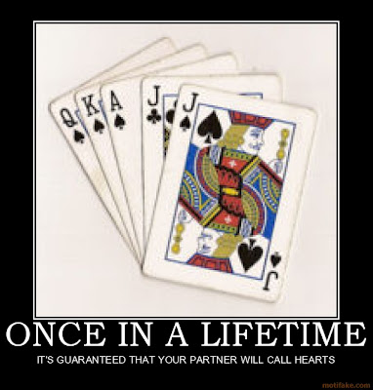
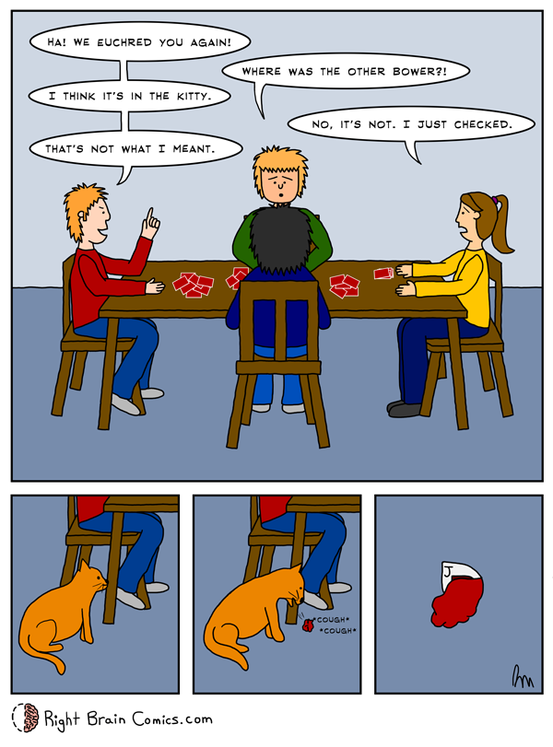
Questions? Comments? Conclusion!

